Slide 1
Crystals And Structure

Slide 2
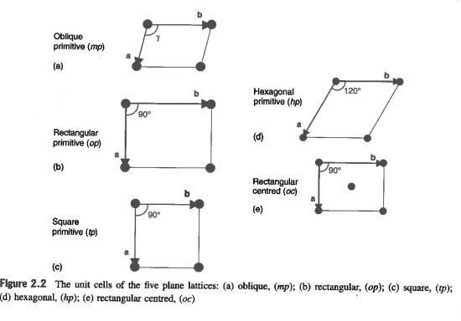
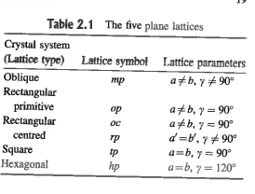
2d lattices

Slide 3
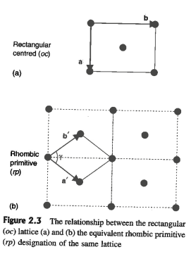
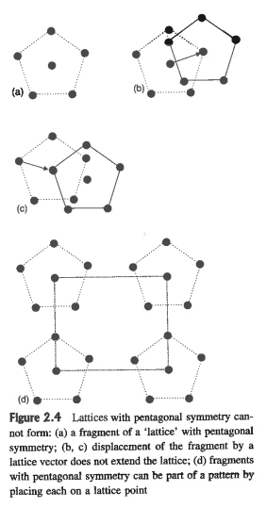

Slide 4
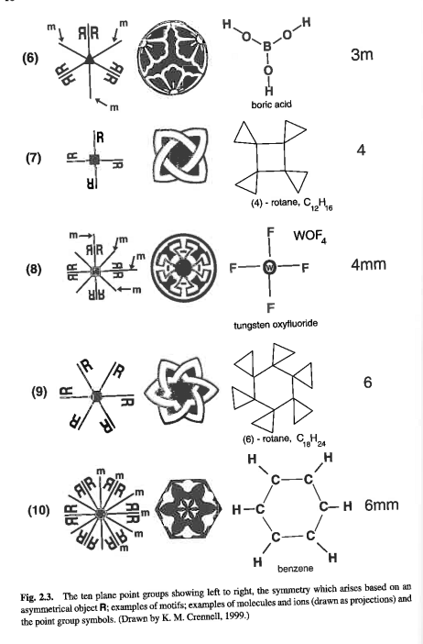
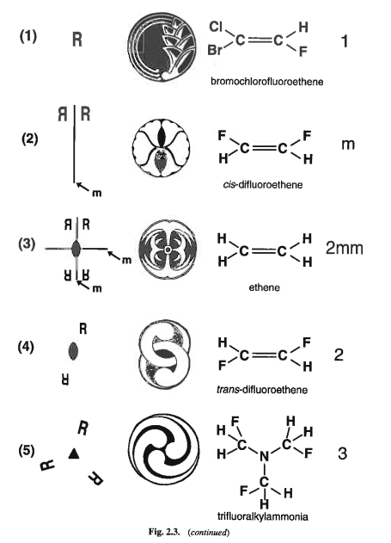
Symmetry Operations in 2d

Slide 5
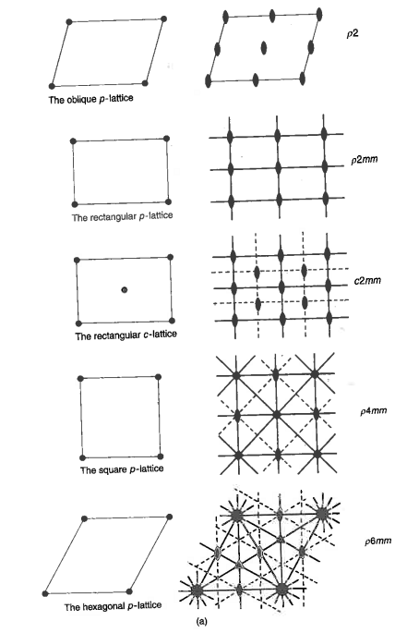
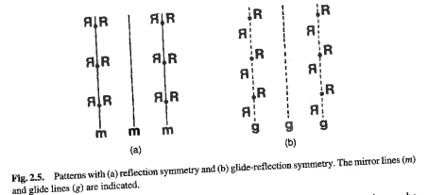

Slide 6
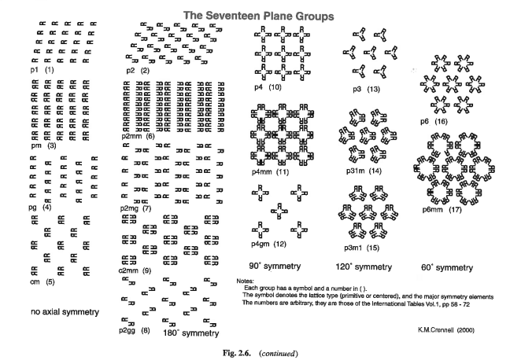

Slide 7
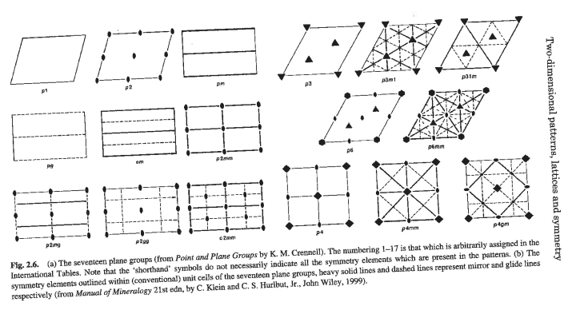

Slide 8
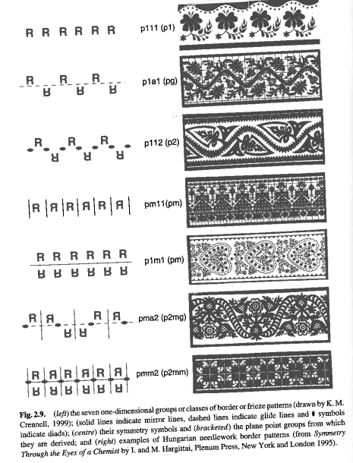
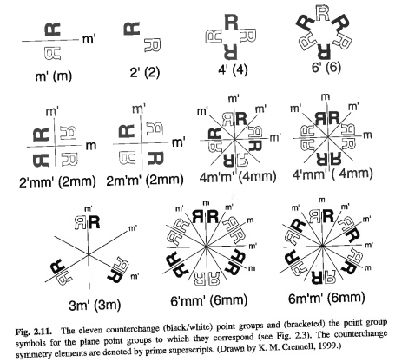
‘Color’ changes (spin):

Slide 9
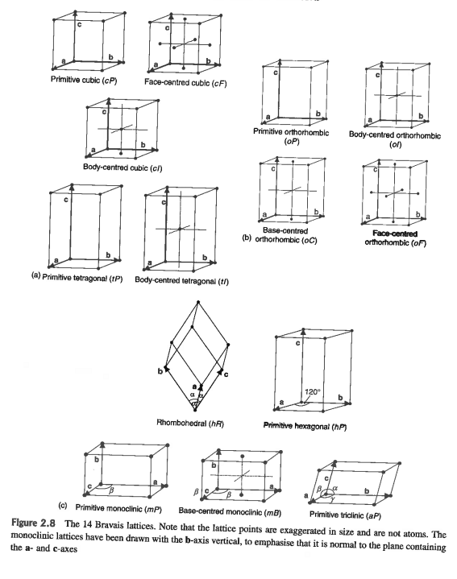
3d lattices

Slide 10
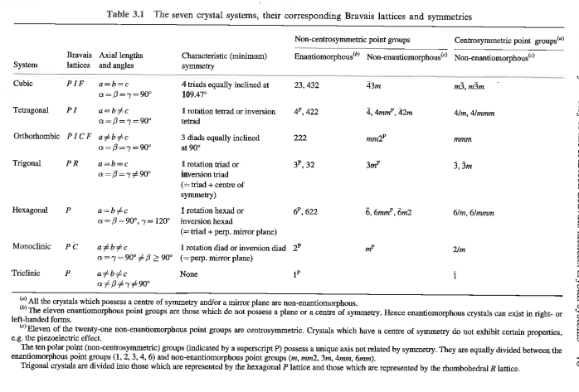

Slide 11
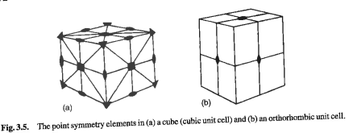
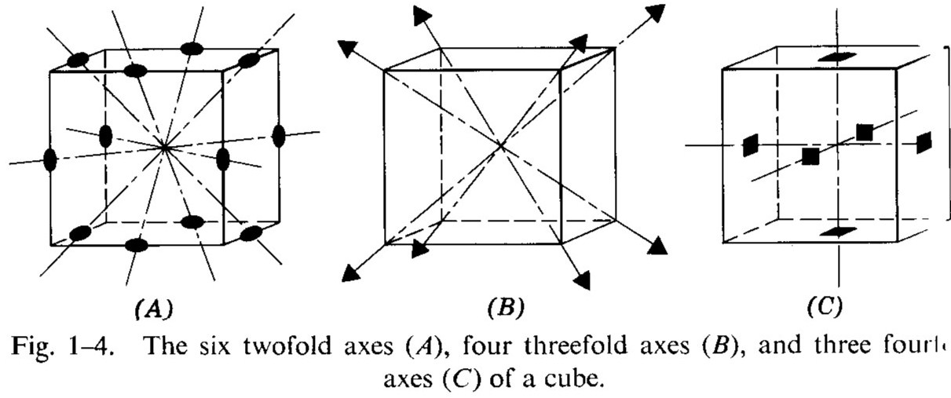
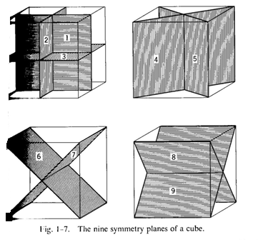

Slide 12
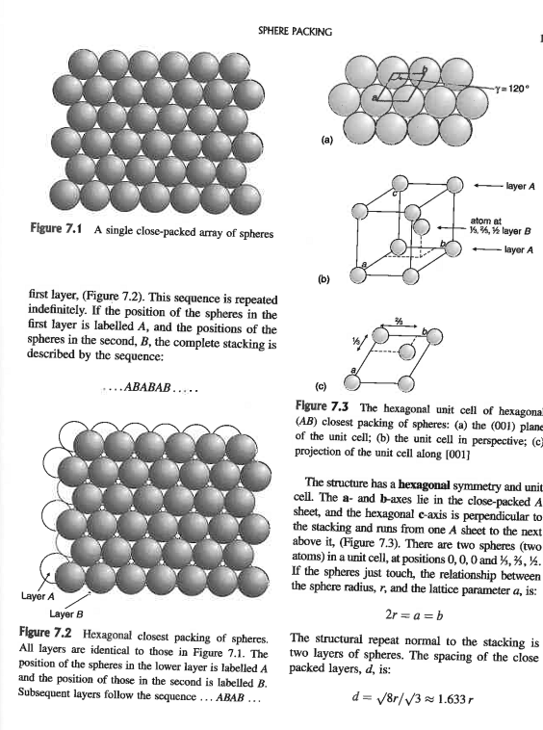
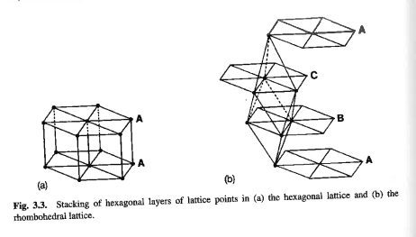

Slide 13
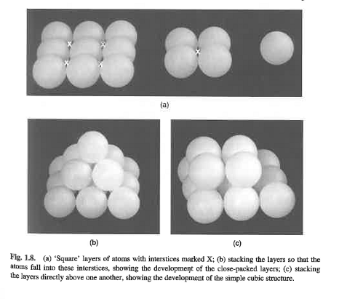
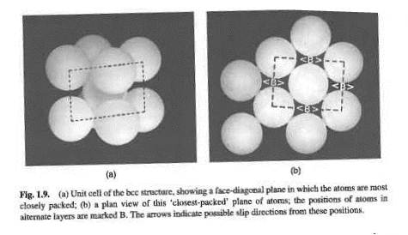
Stacking sequences:

Slide 14
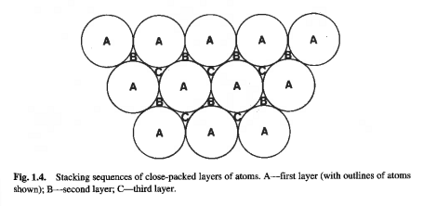

Slide 15
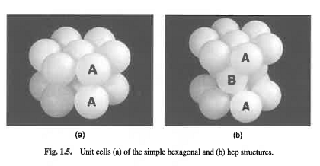

Slide 16
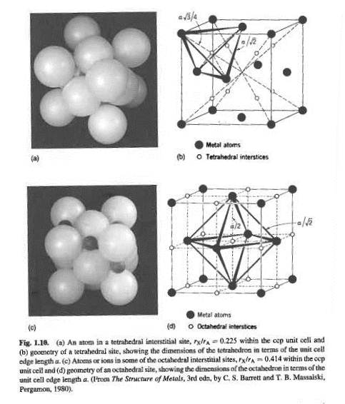
Stacking and
Coordination
polyhedra

Slide 17
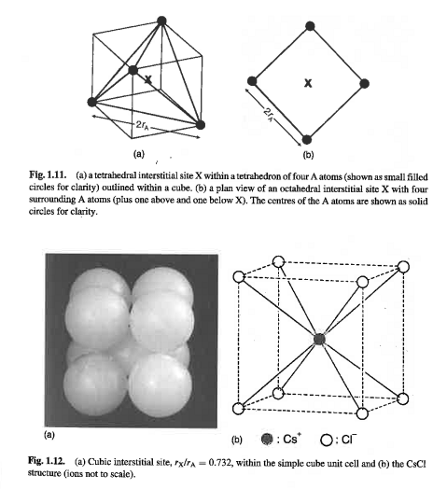

Slide 18
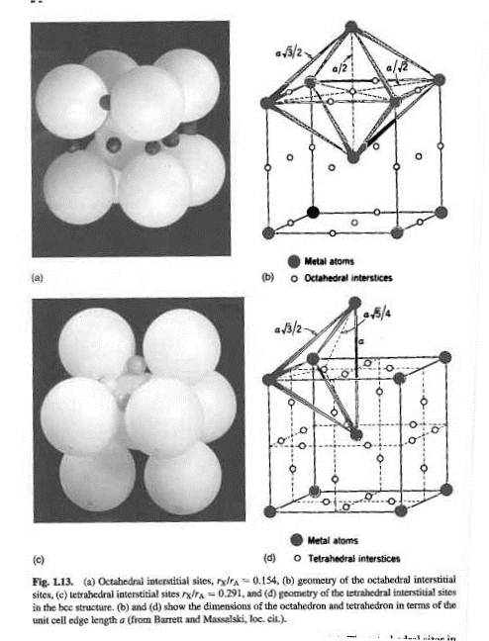

Slide 19
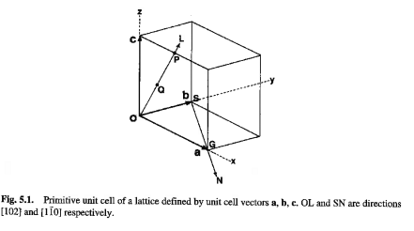
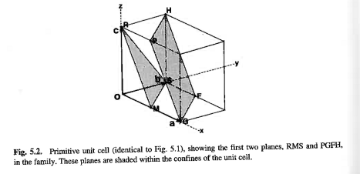
Miller Indices

Slide 20
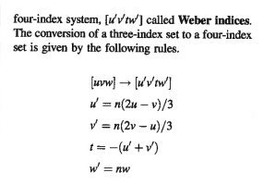
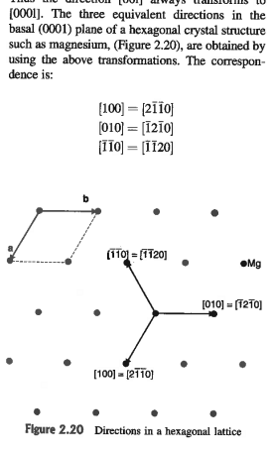

Slide 21
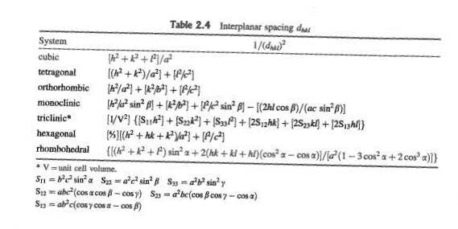
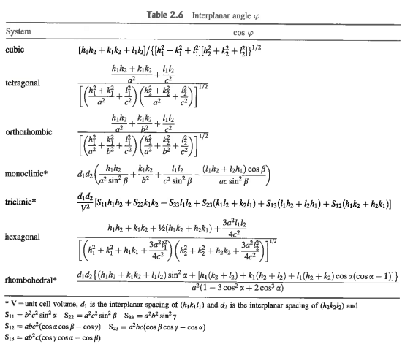
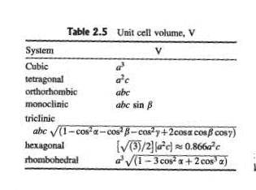

Slide 22
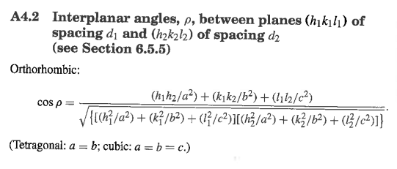
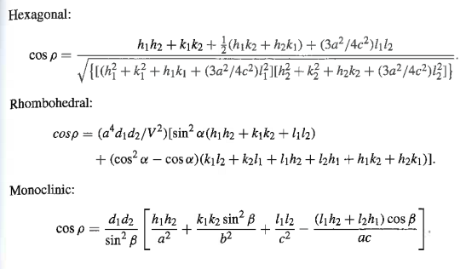

Slide 23
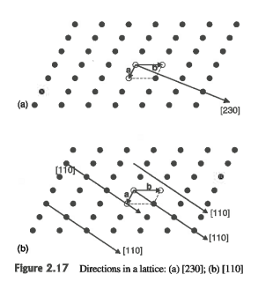
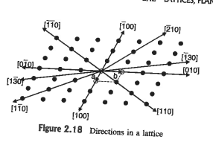
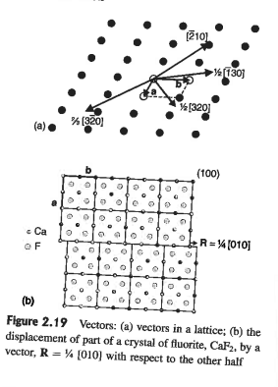

Slide 24
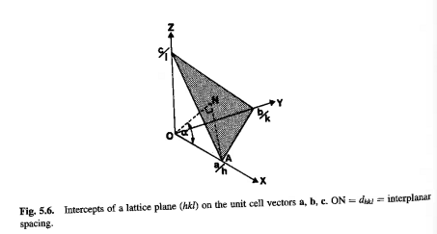
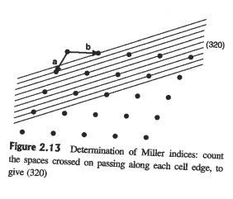
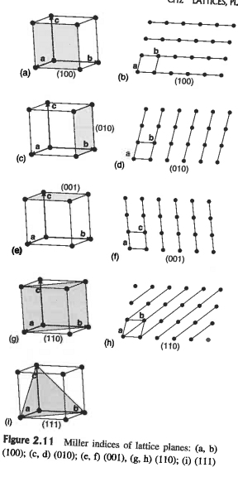
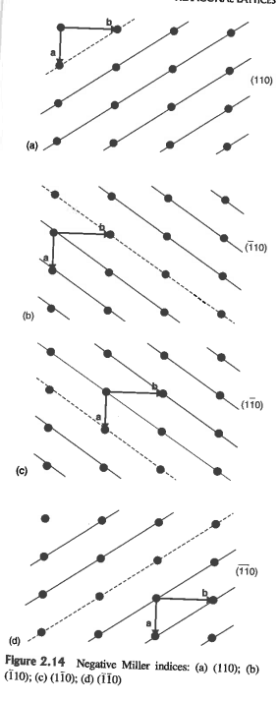

Slide 25
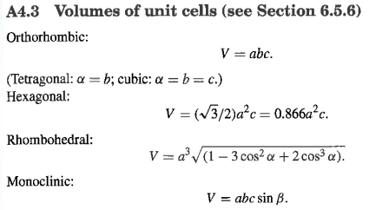
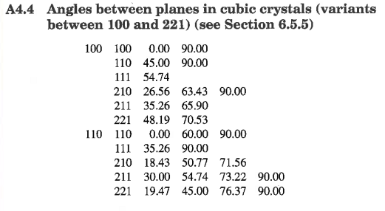
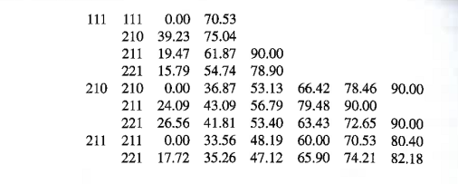

Slide 26
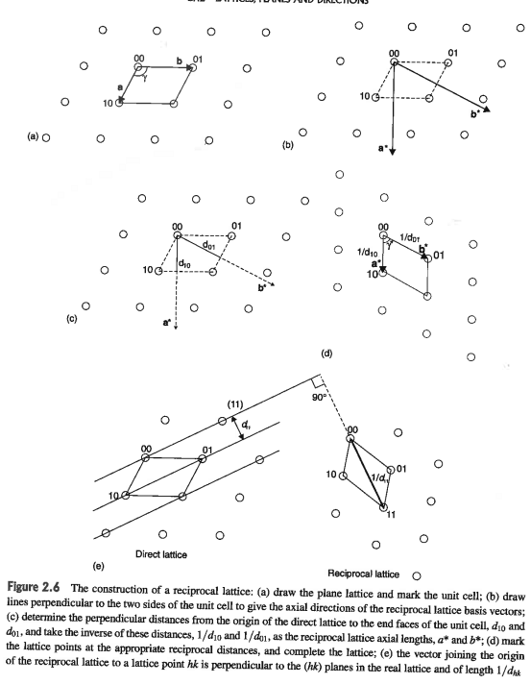
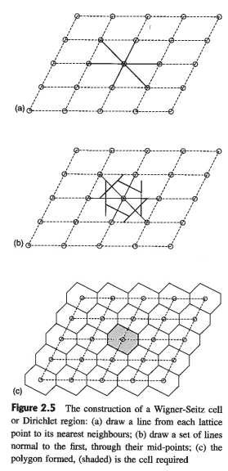
Reciprocal Lattice And Wigner Seitz
cells

Slide 27
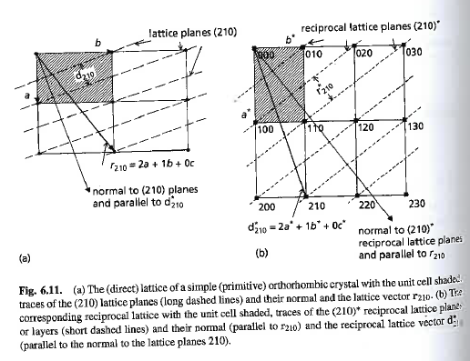

Slide 28
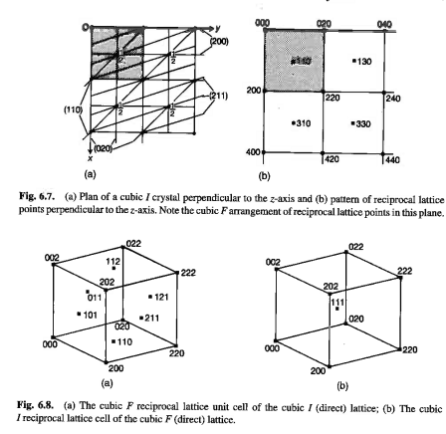
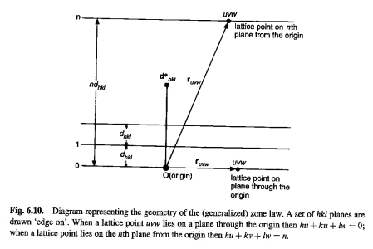

Slide 29
3d reciprocal lattice

Slide 30
Example: monoclinic cell

Slide 32
3d Wigner-Seitz cells

Slide 33
Brillouin Zones

Slide 34
3d Brillouin zones

Slide 35
Polyhedra in k-space Brillouin Zones

Slide 41
Geometry of Grain Boundaries

Slide 42
32 xtal classes: same class = same point
group symmetry:
Centers and inversion axes
Translation symm, screw axes

Slide 45
Space groups

Slide 52
Quasi-crystals

Slide 53
quasiperiodic in two dimensions (polygonal or dihedral quasicrystals) - There is one periodic
direction perpendicular to the quasiperodic layers.
• octagonal quasicrystals with local 8-fold symmetry [primitive & body-centered
lattices]
• decagonal quasicrystals with local 10-fold symmetry [primitive lattice]
• dodecagonal quasicrystals with local 12-fold symmetry [primitive lattice]
quasiperiodic in three dimensions - no periodic direction
• icosahedral quasicrystals with 5-fold [primitive, body-centered & face-centered
lattices]
• icosahedral quasicrystal with broken symmetry (stable binary Cd5.7Yb)
: Structures of quasi-crystals
QC alloys obviously do not belong to the conductor family; nor are they typical insulators
since conductivity is significantly restored upon heating.
reduced wetting, a low friction coefficient, high hardness, elevated corrosion resistance, a ductilebrittle
transition, and superplasticity above 700°C
Properties of quasi-crystals:

Slide 54
Glasses
SiO2 Quartz, amorphous glass, doped

